Slide 1
Humber, Coast and Vale Health and Care Partnership VCSE Leadership Programme
Gary Sainty – VCSE Programme Director
Notes:
This slide deck is to be provide an overview of the VCSE Leadership Group and its work areas.
The slides are designed for people to use the relevant slides when discussing the VCSE Leadership Programme

Slide 2
What is an ICS?
Integrated care is about giving people the support they need, joined up across local councils, the NHS and other partners.
Integrated Care Systems - https://youtu.be/mz4FFE2y8PM
New partnerships between the organisations that meet health and care needs across an area
Coordinated services
Improve population health and reduce health inequalities
Part of the NHS Long Term Plan
Partnership working between voluntary sector, local government and the NHS is crucial to improving care for people and communities
Notes:
Taken directly from VCSE Leadership Group Terms of Reference

Slide 3
Legislative Changes
Draft White Paper – Next Steps for Integrated Care Systems
Integrated Care Systems to become statutory bodies as of 1 April 2022
Abolition of Clinical Commissioning Groups
Integrated partnership between commissioners and providers
Relaxation of current NHS procurement legislation
System, place and neighbourhood arrangements
Legislation anticipated summer 2021; shadow arrangements in place by late autumn 2021

Slide 4
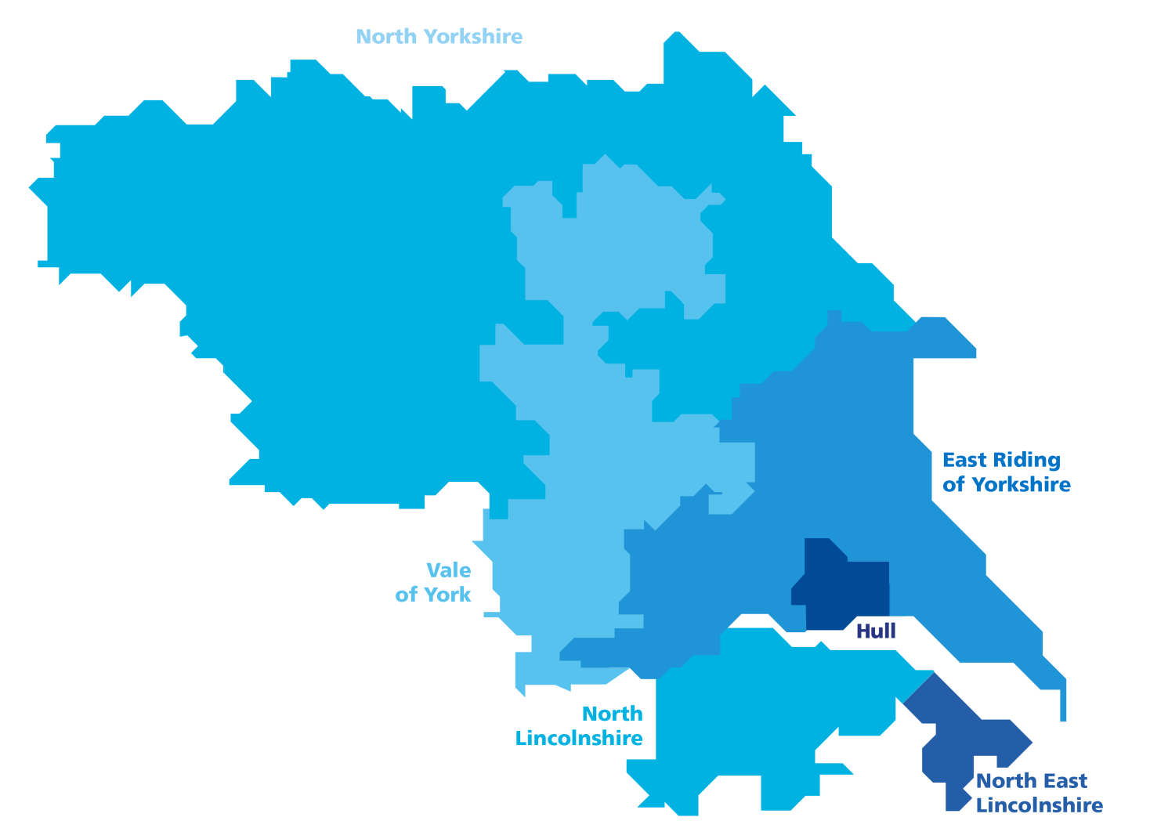
Humber, Coast and Vale
4 acute hospital trusts
(operating across
9 sites)
1.7 million people
Circa 50,000 staff across health and adult social care
3 mental health
trusts
Total budget of
approx. £3.5bn
4 community / not for profit providers
450 care
homes
34 Primary Care Networks
140 home care
companies
2 ambulance trusts
7 hospices
6 clinical commissioning groups (CCGs)
6 local authorities
1000s of voluntary and community sector organisations
Notes:
GS

Slide 5
VCSE Programme
The vision…
‘to influence and facilitate greater collaboration between the Humber, Coast and Vale Health and Care Partnership and the Voluntary, Community and Social Enterprise Sector, enhancing the role of the VCSE sector in the delivery of the transformation of health and wellbeing and cementing their role as a key strategic partner’
Notes:
Taken directly from VCSE Leadership Group Terms of Reference

Slide 6
VCSE Programme Outcomes
The VCSE is represented, has a voice and influences system transformation and the design of services
Greater investment into the VCSE for health service delivery
Deeper understanding of the relationship between system, place and neighbourhood
VCSE and statutory sector organisations have better relationships built on trust and respect
System, place and neighbourhood levels communicate, inform and influence one another effectively
Design of the health and care system is informed by the changing needs of the population and health inequalities are reduced
A greater connection to people and their needs are put at the heart of what we do
Notes:
These have been taken / written from a number of conversations and document such as NHSEI outcomes and NCVO plan following facilitated workshop.

Slide 7

VCSE Programme Connectivity
SYSTEM
VCSE connected at a system level through the leadership group and the various HCV programmes
VCSE Leadership Group
PLACE
East Riding of Yorkshire
Vale of York
North Yorkshire
At ‘place’, networks and connections exist that are linked to the system via the place leads
Kingston upon Hull
North Lincolnshire
North East Lincolnshire
NEIGHBOURHOOD
At a local level the people and the communities make up the area that need to connect through their ‘place’
Community Organisations / PCN’s / People
Notes:
GS

Slide 8
Six Places. One Sector
Notes:
GS

Slide 9
Programme Progress
Dedicated Programme Director – Gary Sainty
Budget in place for 2021/22
VCSE Leadership Group with identified Place leads
Thematic workstreams
Promotion of work to various national / regional networks
Work areas in progress:
Mental Health
Workforce
Cancer
Waiting Well
Social Prescribing
Population Health
Tenders
BAME Mapping
Economic Investment
Notes:
These have been taken / written from a number of conversations and document such as NHSEI outcomes and NCVO plan following facilitated workshop.

Slide 10
Moving Forward 2021/22
Develop VCSE strategic plan to include:
‘Waiting Well’ cardiology pilot
Green Social Prescribing
Social prescribing network
Communications – awareness / visibility
Workforce
BAME community leadership
Working through thematic and geographical networks
Shifting focus to place and neighbourhood
Further integration with ICS priorities
Notes:
These have been taken / written from a number of conversations and document such as NHSEI outcomes and NCVO plan following facilitated workshop.

Slide 11
VCSE Leadership Programme
Gary Sainty – VCSE Programme Director
Gary.Sainty@NHS.net
Notes:
This slide deck is to be provide an overview of the VCSE Leadership Group and its work areas.
The slides are designed for people to use the relevant slides when discussing the VCSE Leadership Programme

