Slide 1
York VCSE Assembly
Health and Care in York
Wednesday 25 January 2023

Slide 2
Volunteers at the heart of the
Health and Care System
Alison Semmence, Chief Executive, York CVS

Slide 3
180 days of action on workforce
 | Making HNY a better place to live and work
Strategy pillar | Be the Best Place to Work |  | Grow and train our workforce |  | Demonstrate system leadership |  | Embrace new ways of working |  | Building strong foundations
Strategy sub-pillar | Supporting staff health and wellbeing | Supporting inclusion and belonging | Growing the workforce of the future and ensuring adequate workforce supply | Educating, training and developing people and managing talent | Valuing and supporting leadership at all levels | Supporting system design and development | All sectors workforce transformation including VCSE | Carers and volunteers | Transforming People Services and supporting the People profession | Leading coordinated workforce planning using analysis and intelligence
180 day workstream | Supporting Inclusion and Wellbeing | Actively supporting colleagues from under represented groups | Ethical international recruitment | One system, learning together | Upskilling leaders for retention |  | Homecare workforce redesign | Volunteers at the heart of the system | One system, recruiting together | Telling the People story
SRO | Paul Hagan, University of Hull |  | Nigel Wells, HNY ICB – broader IR agenda; Mike Reeve, Navigo - Kerala | Jacqui Laycock, CHCP | Claire Hansen, HASR |  | Jamaila Hussain, York CC – York and N Yorks Tracey Meyerhoff, Hull CC - Humber | Alison Semmence, York CVS | Stephen Eames, HNY ICB | Simon Nearney, HUTH
Convenor | Emma Marshall |  | Katy Marshall | Amanda Fisher | Simon Dunn |  | Rachel Baillie Smith | Gary Sainty | Emma Kirkwood | Simon Dunn
Task and finish objectives | Scoping cost of living support offers across the System Researching inclusion and wellbeing best practice Collaboratively promoting Black History and Disability Awareness months Consolidating system-wide coaching opportunities |  | Delivering the Kerala partnership | Creating a comprehensive view of training and education available to people working across the System Identifying access issues and prioritising areas for resolution | Using qualitative and quantitative data to identify specific areas of retention good practice and challenge System-wide Supporting leaders to consider their retention challenges and design local solutions |  | Accelerating delivery of a new concept for homecare in neighbourhood teams, combining social care and prevention Developing and testing an innovative recruitment model, taking care to value and retain existing homecare staff | Engaging both volunteers and volunteer managers to scope the experiences and processes currently in place to recruit, manage and retain volunteers Developing shared principles for volunteering and developing a proposal for a single volunteer hub | Building a shared vision for a single System-wide recruitment front door to enable rapid access into and between roles Developing a costed business case and securing funding | Creating a shared five-year view of the future System workforce in shape and size Enabling access and consensus to ensure this story is at the heart of workforce planning across the System

Slide 4
Volunteers at the heart of the systems workstream
Purpose of the Group
To focus on volunteering practices, principles and experience across the Humber and North Yorkshire health and care system, with a view to enabling greater management and valuing of volunteers.
The task and finish group is designed to understand the landscape of volunteering across all parts of the health and care system, identifying good practice and areas for development and creating a long-term plan for volunteering across the system.

Slide 5
Volunteers at the heart of the systems workstream
Role and responsibilities of the Group
To understand current practice across the system for recruitment, deployment and retention of volunteers
To identify and share best practice around volunteering and effective management of volunteers
To scope the experiences of volunteers that are working in parts of our system, to understand their needs and whether they are being met
To enable volunteers to be aware of and take up a variety of volunteer opportunities and break down barriers that curtail this

Slide 6
Volunteers at the heart of the systems workstream
Role and responsibilities of the Group
To connect partners from across the system to support and develop volunteering
To co-design a set of shared principles that underpins the volunteer processes and practices
To maximise the impact that volunteers have on the system and ensure this is recognized and valued
To monitor the delivery of identified work to support the scoping and understanding of volunteering across the system
To plan what future work is needed to embed volunteering at the heart of the system in future years

Slide 7
York Volunteering Strategy
Drew Richardson, Volunteer Centre Manager, York CVS

Slide 8
York Volunteering Strategy
Co-produced by VCSE organisations across the city
  Focus groups and survey
  Working group
It focuses on how we can collaborate better towards:
The City's priorities
Good practice
Equality, diversity and inclusivity
Promoting volunteering
Recognising and celebrating Volunteers
Sharing skills
Evaluating & monitoring Volunteer impact
It is essential that Volunteers are managed and supported properly to ensure they have a positive experience and they keep volunteering, if possible.
Consistent

Slide 9
Volunteer Management in Health and Care – Best Practice Guidance
Drew Richardson, Volunteer Centre Manager, York CVS

Slide 10
Best Practice Guidance
Why?
Health sector's increased dependence on Volunteers (COVID / post-COVID / workforce pressures)
Volunteer retention and experience

Slide 11
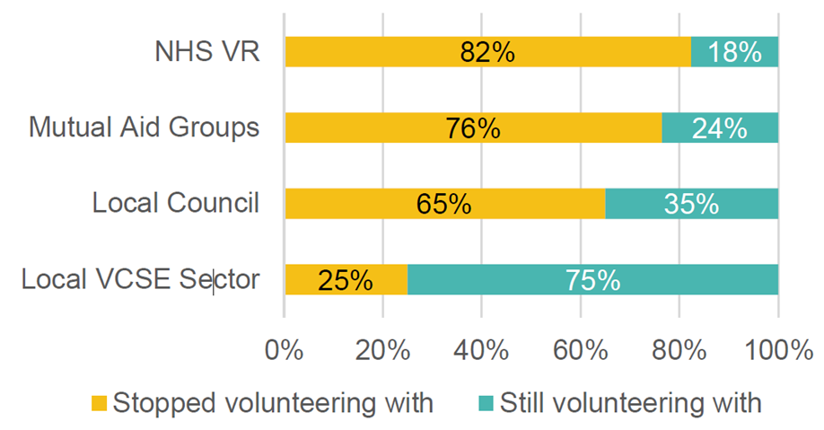
Volunteer Retention
Why?
Health sector's increased dependence on Volunteers (COVID / post-COVID / workforce pressures)
Volunteer retention and experience

Slide 12
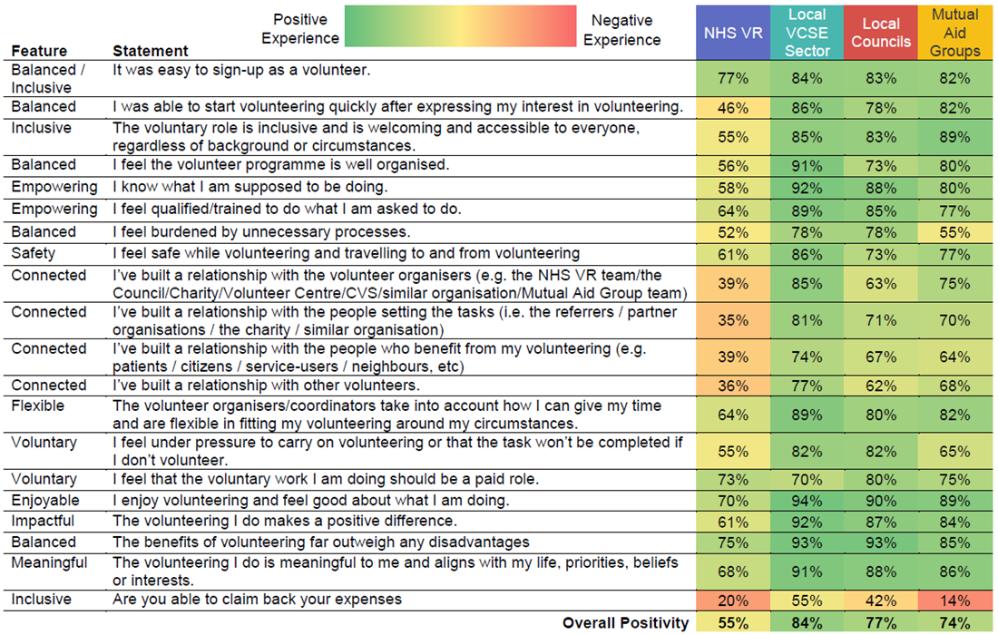
Volunteer Experience
Why?
Health sector's increased dependence on Volunteers (COVID / post-COVID / workforce pressures)
Volunteer retention and experience

Slide 13
Best Practice Guidance
Why?
Health sector's increased dependence on Volunteers (COVID / post-COVID / workforce pressures)
Volunteer retention and quality of their experience
Examples of bad practice
Subsequent Volunteering Crisis – in everyone's best interest

Slide 14
Best Practice Guidance
What we're doing:
Jonny supporting organisations (especially healthcare) with Volunteering Best Practice
Free Volunteering Best Practice Training: https://www.yorkcvs.org.uk/york-cvs-training-and-events/
An 'Involving Volunteers Guide' for healthcare organisations
Free One-to-one support with any queries
Free Volunteer recruitment support
Notes:
Upcoming training:
Managing Volunteers: The Basics
Developing a Volunteering Policy/Handbook
Growing Your Trustee Board
Volunteer Motivations & the 3Rs: Recruitment, Retention, Recognition
Involving Volunteers Guide includes:
What is volunteering?
Why might you involve Volunteers in your organisation?
What tasks are appropriate for Volunteers; what isn't?
Differences and similarities between Staff & Volunteers
Writing a Volunteering Policy
Choosing Volunteers' tasks
Creating Volunteer Roles
Recruiting Volunteers
Training Volunteers and what should be included
Measuring impact
Paying expenses
Supervision Volunteers
One to one catch ups
Problem solving (when volunteering is not going to plan)
The end of Volunteering relationships

Slide 15
Volunteers at the heart of the systems workstream
Appropriate or Not…?

Slide 16
Appropriate or Not…?
Feeding Patients

Slide 17
Appropriate or Not…?
Doing Laundry

Slide 18
Appropriate or Not…?
Making Beds

Slide 19
Appropriate or Not…?
Decontaminating Surfaces

Slide 20
Appropriate or Not…?
COVID Vaccines

Slide 21
Appropriate or Not…?
Toenail Cutting

Slide 22
Appropriate or Not…?
Hospital Administration

Slide 23
Appropriate or Not…?
Personal Grooming

Slide 24
Volunteering Principles and Charter
Alison Semmence, Chief Executive, York CVS

Slide 25
Volunteering Principles and Charter
Round table discussions:
Are there any guiding principles you don’t agree with?
Is there anything in the legal and best practice framework you don’t agree with?
Is anything missing?

Slide 26
CLOSE
Next meeting:
16 February, 10am – 12noon
8 March, 10am - 12noon

