Slide 1
Welcome
York VCSE Assembly
Children and Young People’s
Mental Health
Tuesday 16 May 2023

Slide 2

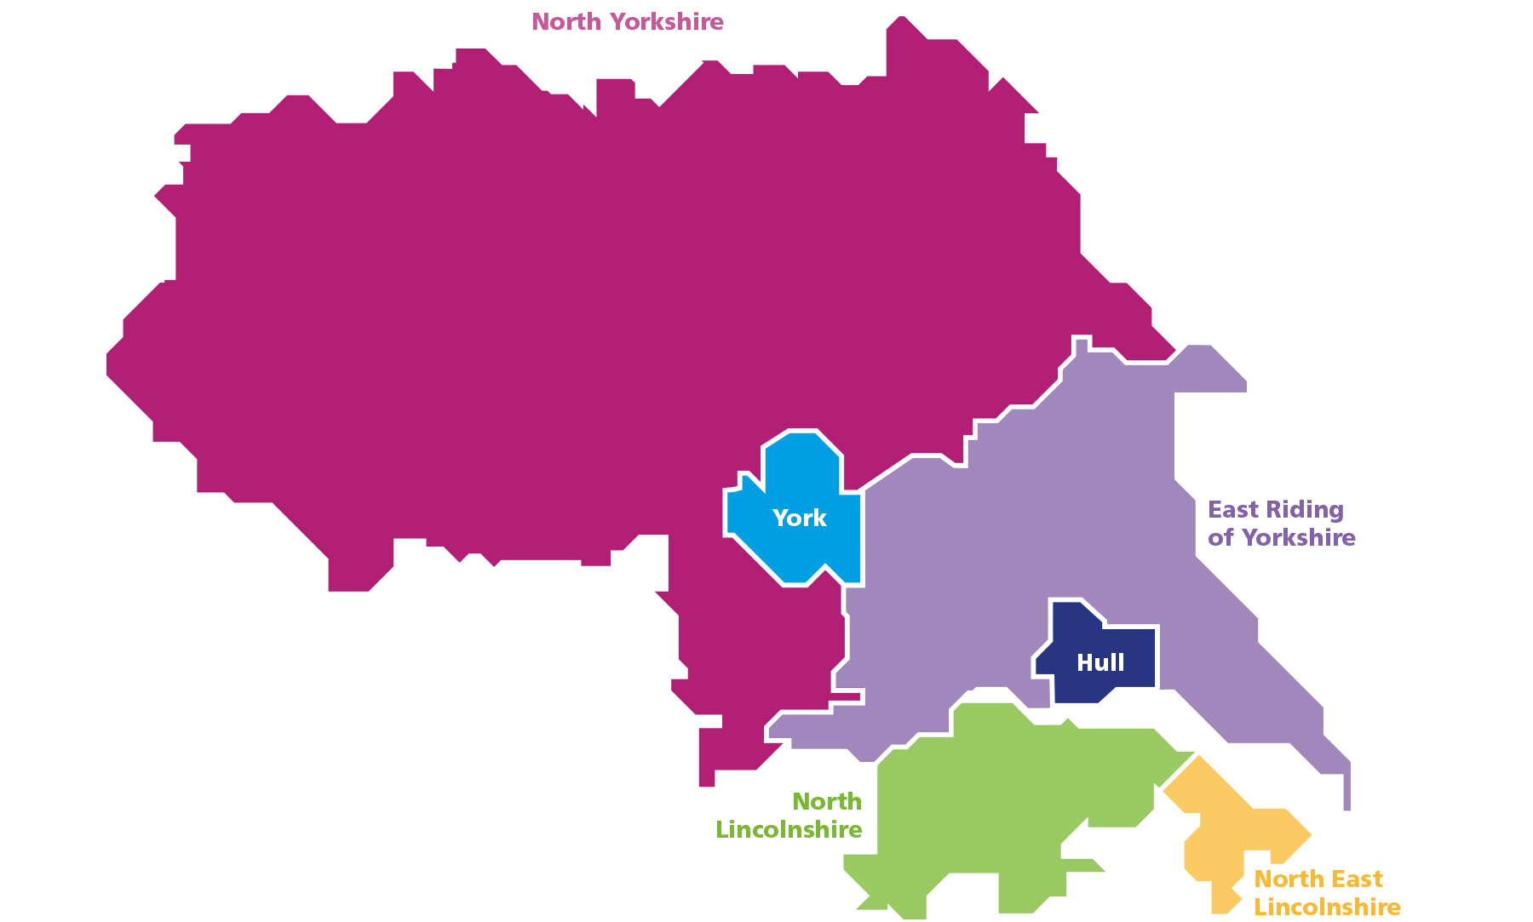
Humber and North Yorkshire Health and Care Partnership
Our Partnership’s ambition is for everyone in our area to: start well, live well and age well
Integrated care systems (ICSs) are partnerships of organisations that come together to plan and deliver joined up health and care services, and to improve the lives of people who live and work in their area.
Humber and North Yorkshire Health and Care Partnership became a statutory body on 1st July 2022.
Four key aims:
Improving outcomes in population health and health care
Tackling inequalities in outcomes, experience and access
Enhancing productivity and value for money
Support broader social and economic development
Notes:
This is the HNY HCP Partnership geography, vision and key aims of an ICS

Slide 3

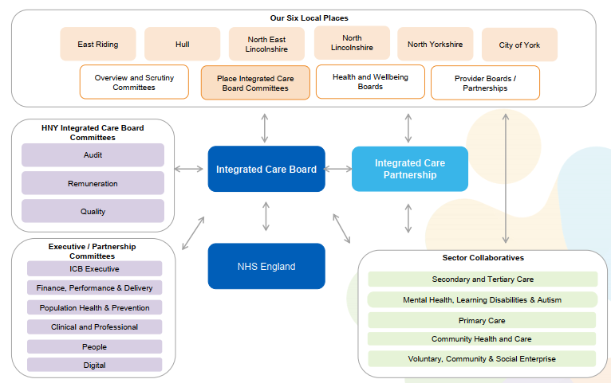
HNY Governance
Notes:
This slide is the HNY HCP Governance.
To note: the VCSE Collaborative is part of the system wide governance and we will work closely with other collaboratives and places. The VCSE Collaborative is possibly the first in the country, certainly only a handful of ICS’s have this in their structure.
In addition, the VCSE is represented at the ICB by the Chair Jason Stamp

Slide 4
HNY VCSE Collaborative - Membership
North Lincolnshire
Susan Oliver
Humber and Wolds Rural Action
North East Lincolnshire
Claire Etheridge
Forum
East Riding of Yorkshire
Andy Barber
Smile Foundation
North Yorkshire
Jane Colthup
Community First Yorkshire
Hull
Jason Stamp*
Forum
Vale of York
Alison Semmence
York CVS
HNY VCSE COLLABORATIVE
*denotes chair
Humber Geographical Partnership Rep.
Erica Dailey
North Yorkshire and York Geographical Rep.
Sam Haward
Humber and North Yorkshire Health and Care Partnership
Gary Sainty
Investment Lead
Jan Garrill
Two Ridings Community Foundation
Notes:
Orange – Place Leads
Purple – Geographical Partnership Representatives
Blue – HCV Partnership Lead
Green – Finance Lead

Slide 5
York VCSE Assembly
Objectives:
To support VCSE-VCSE Sector Collaboration
To support VCSE-Public Sector Collaboration
To lever in resource and facilitate investment
To build VCSE capacity
To facilitate representation

Slide 6
Room Introductions

Slide 7
Children and Young People’s Mental Health Programme
Gail Teasdale
CYP Mental Health Programme lead
Mental Health, Learning Disabilities and Autism Collaborative Programme
Humber and North Yorkshire Health Care Partnership

Slide 8


Population: 1.7 million

Slide 9

Children and Young Peoples Mental Health Steering Group – Partnership working across the system
Humber and North Yorkshire Health Care Partnership (place)
Mental Health provider Trusts – Managers and Clinical Leads – Inpatient and Community) (Place
Specialist Provider Collaborative (Inpatients) (ICS)
Learning Disabilities and Autism (ICS)
CYP Clinical Lead (ICS)
Local Authority –Childrens services and Public Health (place)
Voluntary and Community Sector mental health providers (place)
CYP Trauma Informed Care Programme (ICS)
CYP Engagement and Coproduction (ICS)
Perinatal and Maternal Health (ICS)
NHS England (Yorkshire and Humber)
OHID (formerly Public Health England) (Yorkshire and Humber)

Slide 10
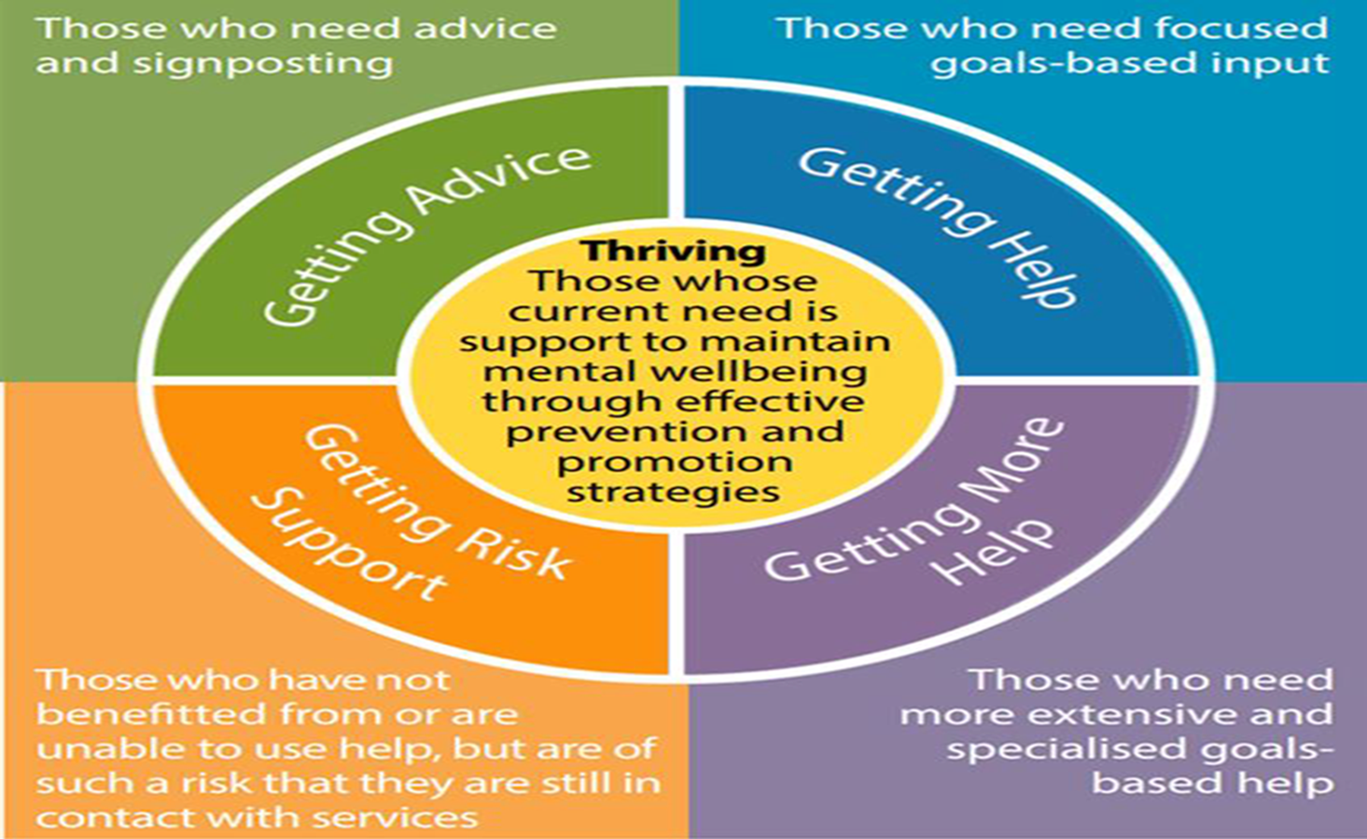
Children and Young Peoples Mental Health – Partnership working across the system

Slide 11
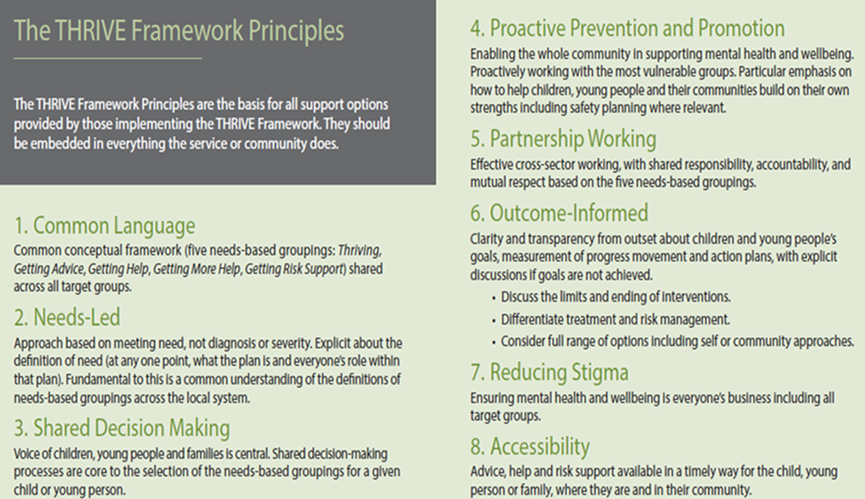
Children and Young Peoples Mental Health – Partnership working across the system

Slide 12
Deliver the priorities of the NHS Long Term Plan - Building on 5 years forward – 10 year plan:
Provide joined up care at right time in right setting (including online and face to face).
Improved focus on population health management including predictive prevention and early intervention to help people stay healthy and reduce demand on clinical services.
Reduce Health Inequalities and impact of poor health on wider outcomes e.g., employability
Addressing unmet need and local variations

Slide 13
Overall Systems Architecture with specific focus on:
Workforce
Digital
Innovation
Efficiency

Slide 14
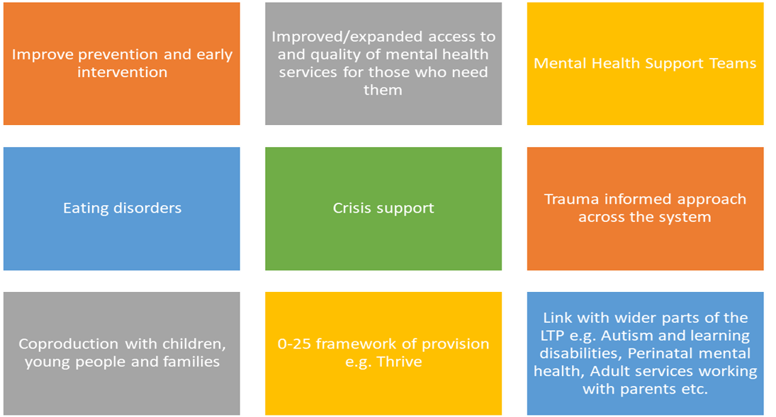
To successfully deliver Long Term Plan priorities:

Slide 15
Priorities in our Humber and North Yorkshire CYP Mental Health Strategic Plan
Robust offer across the Thrive Framework at place to deliver improved mental health outcomes for CYP which include:
improved prevention and early intervention to help people stay healthy and reduce demand on clinical services.
Improved/Expanded access to Mental Health services for those who need them
Systems Approach to Trauma Informed Care
Effective management of risk
Improved engagement and coproduction with CYP
Workforce Development

Slide 16
Achieving our priorities on:
Improved prevention and early intervention to help people stay healthy and reduce demand on clinical services
Improved access to self-care resources and service information for CYP and Families
Work with partners at place to ensure new and established Mental Health Support Teams in Schools are developed, mobilised, and delivered effectively and meet local need
Review and further develop effective early intervention pathways/services to address key CYP MH issues at the earliest opportunity through effective support for lower-level mental health presentations and reduce escalation/crisis.
Increase and improve the training and awareness for all professional working with CYP to support them to identify and intervene to address key mental health issues at the earliest opportunity

Slide 17
Achieving our priorities on:
Improved/Expanded access to Mental Health services for those who need them
Build on work at place to further embed the Thrive Framework across partnerships in Partnership with Anna Freud Centre
Improved clarity of thresholds/pathways for professionals as well as CYP and parents/carers – graduated response for support and development of consistent no wrong door model
Improve pathways/access for vulnerable children and young people e.g., CYP who are looked after, edge of care or have social care involvement, care leavers, in Youth justice service or at risk of homelessness (aged 16-18)
Improved access to family therapy
Establish Task and Finish Group to improve processes to ensure seamless transition from CYP to adult services – needs led not age led
Establish CYPMH Primary Care Integration Pilot to test and support improved service integration, care navigation and access to appropriate mental health support for CYP presenting at primary care settings
Development of CYP data dashboard - Develop and embed routine performance reporting from place-based providers which builds on the current LTP performance targets to provide a clear picture of successes and challenges by service and by pathway including outputs, outcomes and waiting times
Digital scoping - Scoping alternatives to face-to-face models of support to provide a blended offer moving forward building on the learning from the pandemics. This includes consultation and engagement with CYP and families.

Slide 18
Achieving our priorities on:
Effective management of risk
Develop a suicide prevention pathway for CYP including support in escalating cases of self-harm or suicidal ideation or following a suicide attempt.
Review of the step-down arrangements from Crisis particularly after serious self-harm or risk of suicide
Improved and consistent offer of Intensive home treatment across the ICS
Task and Finish group established to prevent admission to inpatient units (where possible) and prevent delayed discharge.
Coordinate the development of a forward plan to reduce CYP admission to acute paediatric wards for Mental Health issues to implement effective solutions to address the needs and challenges

Slide 19
Achieving our priorities on:
Systems Approach to Trauma Informed Care
ICS wide 10 year Strategy that builds on and compliments work at place
Development of Core Programme documents e.g., CYP TIC Strategy, Programme summary, KPI’s, Training audit and plan etc
Support across the system to organisations to embed Trauma Informed care across the system
Establish and facilitiate Communities of Practice to support systems change
Organisational Toolkit to support systems change
Establish a training plan which builds on and compliments training at place including a Training audit
Place based Test and Learn pilots

Slide 20
Achieving our priorities on:
Improved engagement and coproduction with CYP
Establish a children and young people’s ICS wide engagement and co-production strategy and workplan for CYP Mental Health, which builds on and compliments existing place-based activity, to capture and measure the engagement of children and young people and the impact of this
Implement and coordinate regular communities of practice/networks with place-based engagement and coproduction leads/workers across the ICS partners to ensure consistency of approach and peer to peer support and learning between services and partners.
Provide consultancy, advice, and guidance to a wide range of place-based services and partners to support organisations to embed evidence-based practice to enable sustainability of delivery. This includes developing and sharing resources, skills, and knowledge across the ICS
Recruit, train and support a team of young volunteers with lived experience from across the ICS geography, who will act as advisory groups to relevant steering groups, boards etc.

Slide 21
Achieving our priorities on:
Workforce Development
Review current workforce ‘make-up’ and explore alternative workforce models.
Develop career pathways that allow movement across the system and promote continued professional development.
Identify and embed opportunities for skill development within role through role expansions and specialism focus.
Develop system wide training directory and training opportunities across the ICS footprint.
Map expected activity levels to future workforce to allow future proofing our service delivery.

Slide 22
Gail Teasdale
HNY CYP Mental Health Programme lead
Gail.teasdale@nhs.net

Slide 23
York Perspective
Christine Marmion-Lennon on behalf of Susan De Val York Health and Care Partnership
Alyson Scott
Chief Executive, York Mind

Slide 24
Roundtable Discussions:
What can your organisation do individually or in partnership with others to address the points raised today?

Slide 25
Thank you and close
Next Meeting:
12 July, 10am – 12pm, Main Hall

